Slide 1
new-retailing chain store management and sales
GROUP 104
董展潜，刘世晴，詹正道，邹萱萱

Slide 2
explicit purpose
a city-wise new-retailing chain store management system to a company

Slide 3
provide a platform for manager to manage the staff and stored goods, and arrange sales plan
provide a platform for customer to surf and buy goods
provide a platform for deliverer and cashier to use in their daily work

Slide 4
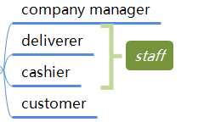
potential users

Slide 5
security
Users use application to access to the database server
the passwords are hashed before being stored into the database
The master database is built on the server.

Slide 6
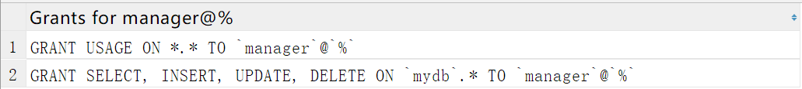
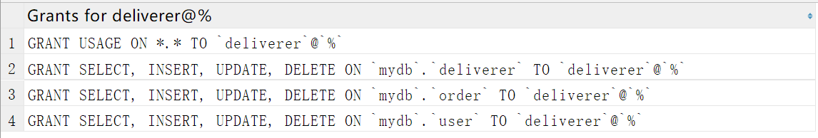
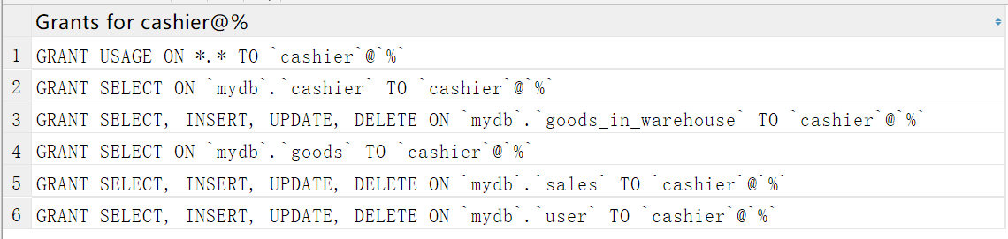

Slide 7
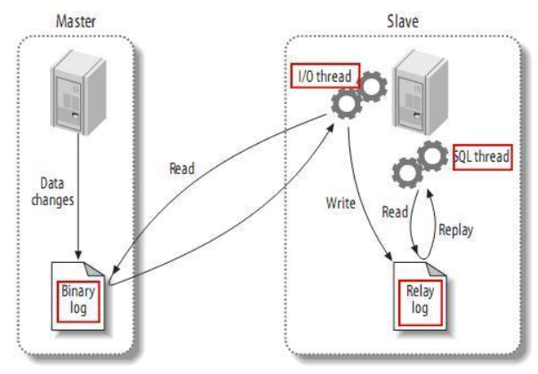
Reliability
using mysql Asynchronous Replication to backup the database

Slide 8
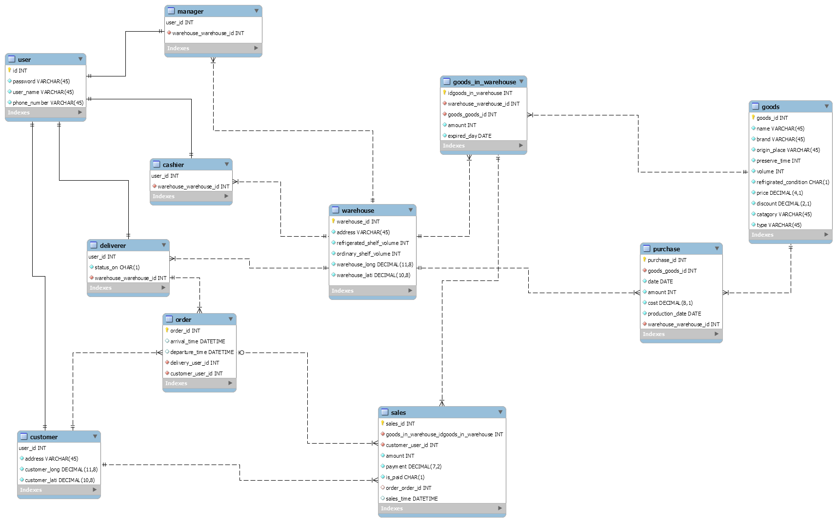
Brief intro to Database Tables

Slide 9
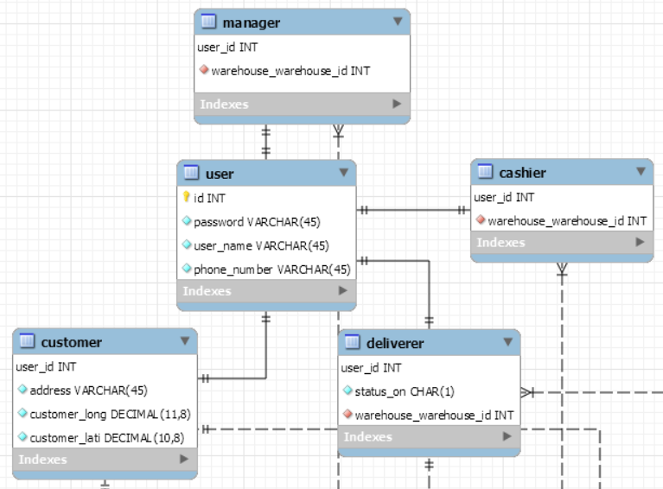
different users

Slide 10
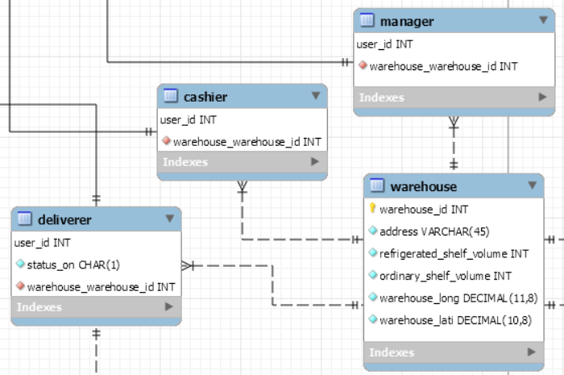
Warehouse & its staff

Slide 11
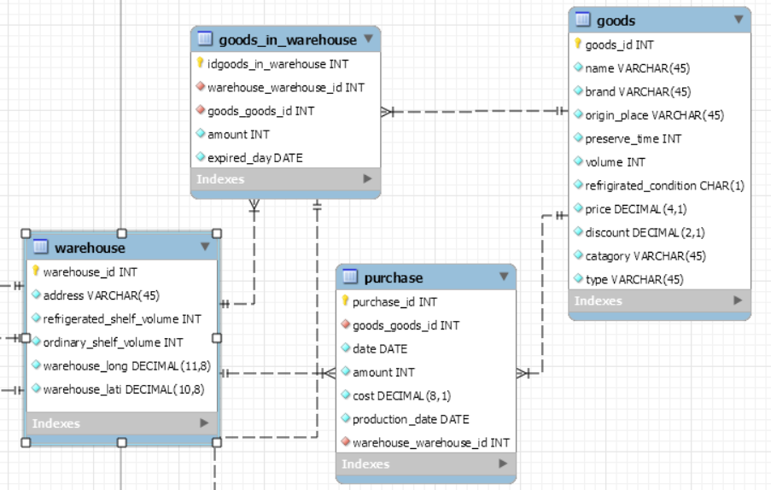
Warehouse & goods

Slide 12
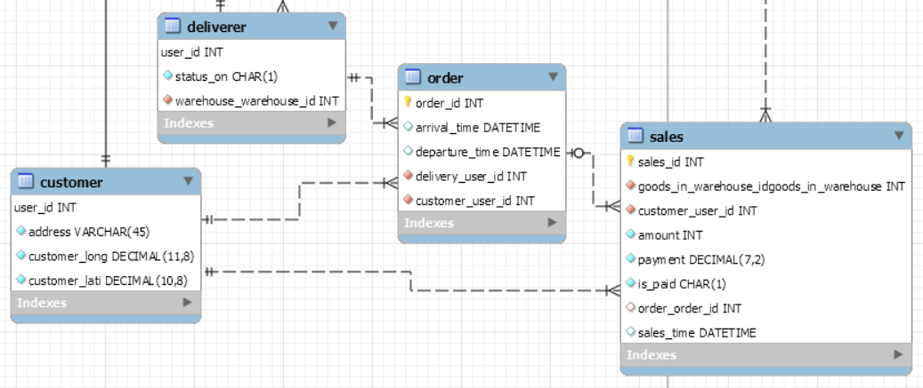
Shopping & delivering

Slide 13
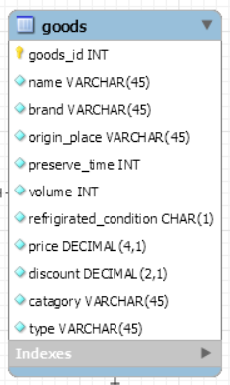
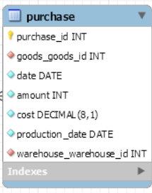
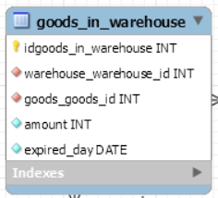
TRIgger & process

Slide 14
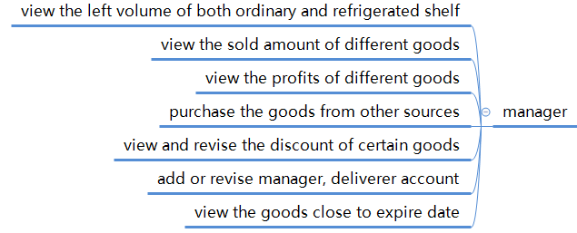
requirements

Slide 15
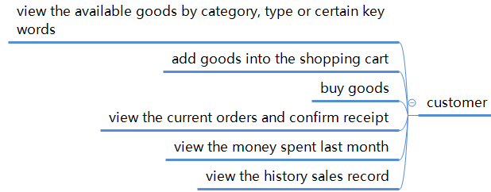

Slide 16



Slide 17
Example
If a manager wants to replenish goods in the warehouse,
First he view the left amount of goods in the warehouse,
Then he view the left volume of shelf to estimate the amount to purchase,
After that he make a purchase order,
The record will also be update in the goods_in_warehouse table.

Slide 18
If a manager wants to revise the discounts of goods,
First he view the goods close to the expire date,
Then he view the profits of different goods and sold amount of different goods,
After that he make sure which goods to be discounted,
Finally he view and revise the discount rate of certain goods.

Slide 19
If a manager wants to add or revise another manager or deliverer,

Slide 20
If a customer wants to buy goods,
First he surfs goods according to types or category,
Then he searches certain kinds of goods by key word,
After that he adds goods into the shopping cart,
He buys the goods in shopping cart,
Finally he views the current orders and confirms receipt after receiving the goods.

Slide 21
TOOLS
Data Crawling – Selenium
Data generating – Faker, Random

Slide 22
Thank you & questions

